Slide 1
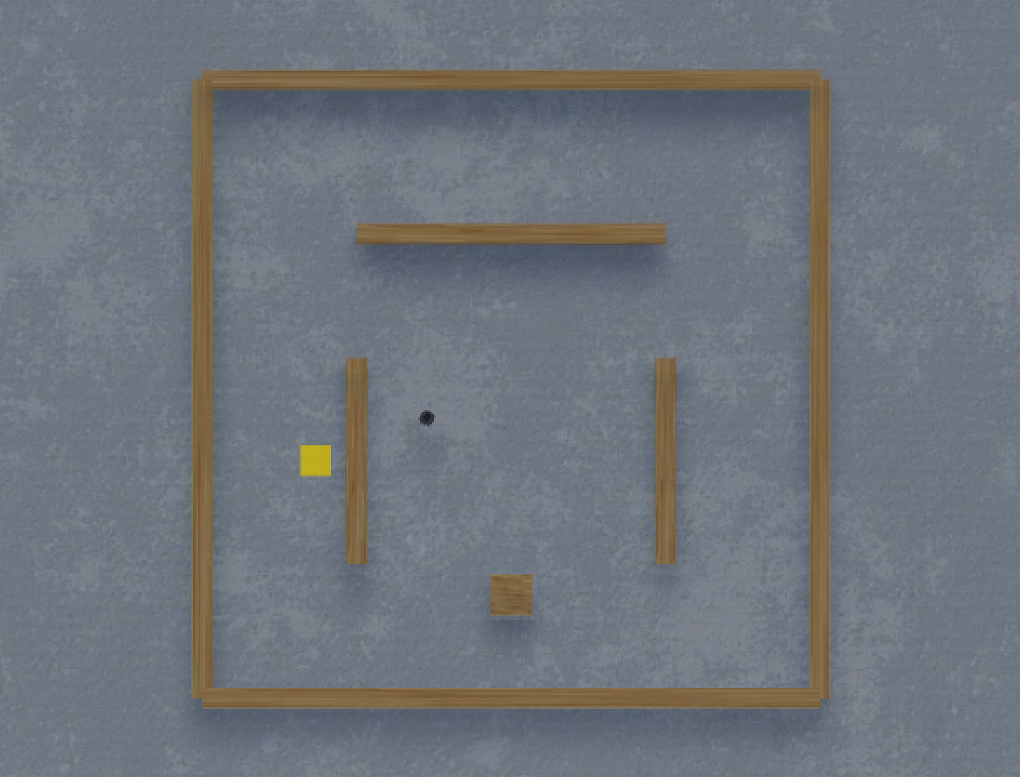
STD_20220530_093434_ZERO_PENALTY_TU-10/models/STD_id238_ep10604_srate97.h5

